Slide 1
System Programming Chapter # 3: Working with Files Lecture # 10 Week # 5 Dr. Muhammad Bilal Qureshi m.qureshi@centralasian.uz
Central Asian University, Tashkent, UZ

Slide 2
Contents
Last lecture:
Files types (regular, directory, pipe, socket, character, block, links)
Devices files /dev (console, tty, null)
Low-level-Access :
read and write system calls
open system call
close system call
Ioctl system call

Slide 3
Low-Level File Access
open
#include <unistd.h>
#include <fcntl.h>
#include <sys/types.h>
#include <sys/stat.h>
int open(const char *path, int oflags);
int open(const char *path, int oflags, mode_t mode);
To create a new file descriptor, you need to use the open system call. In simple terms, open establishes an access path to a file or device. If successful, it returns a file descriptor that can be used in read, write, and other system calls.
The name of the file or device to be opened is passed as a parameter, path; the oflags parameter is used to specify actions to be taken on opening the file. The open call must specify one of the file access modes shown in the following table:
Notes:
This header file contains file control options used for manipulating file descriptors.It provides macros like O_RDONLY, O_WRONLY, and O_CREAT for file opening modes.
<sys/types.h>
This header defines data types used in system calls, such as pid_t, off_t, mode_t, and size_t.
<sys/stat.h>
This header provides structures and macros for retrieving file attributes.
It is used with stat(), fstat(), and lstat() system calls to get file metadata like permissions, size, and timestamps.
It includes macros such as S_IRUSR, S_IWUSR, and S_IXUSR to check file permissions.

Slide 4
Low-Level File Access
Mode | Description
O_RDONLY | Open for read-only
O_WRONLY | Open for write-only
O_RDWR | Open for reading and writing
The call may also include a combination (using a bitwise OR) of the following optional modes in the oflags parameter:
O_APPEND: Place written data at the end of the file.
O_TRUNC: Set the length of the file to zero, discarding existing contents.
O_CREAT: Creates the file, if necessary, with permissions given in mode.
O_EXCL: Used with O_CREAT, ensures that the caller creates the file. This protects against two programs creating the file at the same time. If the file already exists, open will fail.

Slide 5
Low-Level File Access
Initial Permissions
When you create a file using the O_CREAT flag with open, you must use the three-parameter form. mode, the third parameter, is made from a bitwise OR of the flags defined in the header file sys/stat.h. These are:
S_IRUSR: Read permission, owner
S_IWUSR: Write permission, owner
S_IXUSR: Execute permission, owner
S_IRGRP: Read permission, group
S_IWGRP: Write permission, group
S_IXGRP: Execute permission, group
S_IROTH: Read permission, others
S_IWOTH: Write permission, others
S_IXOTH: Execute permission, others

Slide 6
Permission Bits and Their Values
Bit | Octal value | Text value | Corresponding permission
8 | 4 0 0 | - r-- --- --- | Owner may read
7 | 2 0 0 | - -w- --- --- | Owner may write
6 | 1 0 0 | - --x --- --- | Owner may execute
5 | 0 4 0 | - --- r-- --- | Group may read
4 | 0 2 0 | - --- -w- --- | Group may write
3 | 0 1 0 | - --- --x --- | Group may execute
2 | 0 0 4 | - --- --- r-- | Everyone else may read
1 | 0 0 2 | - --- --- -w- | Everyone else may write
0 | 0 0 1 | - --- --- --x | Everyone else may execute

Slide 7
Low-Level File Access
File Permissions
read | We can read and copy a file but can not modify or execute
write | We can modify that file
execute | We can execute but can’t read or modify
Directory Permissions
read | We can list the files and subdirectories contained in that directory.
write | We can create and remove files and subdirectories within it.
execute | We can enter the directory using the cd command

Slide 8
Low-Level File Access
For example
open ("myfile", O_CREAT, S_IRUSR|S_IXOTH);
has the effect of creating a file called myfile, with read permission for the owner and execute permission for others, and only those permissions.
$ ls -ls myfile
0 -r-------x 1 neil software 0 Sep 22 08:11 myfile*
umask
The umask is a system variable that encodes a mask for file permissions to be used when a file is created.
You can change the variable by executing the umask command to supply a new value. The value is a three-digit octal value.
Each digit is the result of ORing values from 1, 2, or 4; the meanings are shown in the following table. The separate digits refer to “user,” “group,” and “other” permissions, respectively.

Slide 9
Low-Level File Access
Digit | Value | Meaning
1 | 0 | No user (owner) permissions are to be disallowed.
 | 4 | User (owner) read permission is disallowed.
 | 2 | User (owner) write permission is disallowed.
 | 1 | User (owner) execute permission is disallowed.
2 | 0 | No group permissions are to be disallowed.
 | 4 | Group read permission is disallowed.
 | 2 | Group write permission is disallowed.
 | 1 | Group execute permission is disallowed.
3 | 0 | No other permissions are to be disallowed.
 | 4 | Other read permission is disallowed.
 | 2 | Other write permission is disallowed.
 | 1 | Other execute permission is disallowed.

Slide 10
Low-Level File Access
For example, to block “group” write and execute, and “other” write, the umask would be
Values for each digit are ORed together; so the second digit will need to be 2 | 1, giving 3. The resulting umask is 032.
You can also use chmod command to set the permissions of a file or a folder. # chmod 755 a.out
You can use chown command to set the ownership of a file or a folder. # chown nobody:nobody widgets
Digit | Value | Description
1 | 0 | Owner can read = 4, write = 2 and execute = 1
2 | 2 1 | Group can read = 4 only
3 | 2 | Others can read = 4 and execute = 1
Notes:
Chown alice:developers myfile.txt
This changes the owner to alice and the group to developers.
chown -R user2 directory/
nobody:nobody: Specifies the new owner and group. "nobody" is a common username and group name used in Unix-like systems for unprivileged processes.

Slide 11
Low-Level File Access
close
#include <unistd.h>
int close(int fildes);
You use close to terminate the association between a file descriptor, fildes, and its file. The file descriptor becomes available for reuse. It returns 0 if successful and –1 on error.
Ioctl
#include <unistd.h>
int ioctl(int fildes, int cmd, ...);
It provides an interface for controlling the behavior of devices and their descriptors and configuring underlying services.
ioctl performs the function indicated by cmd on the object referenced by the descriptor fields. It may take an optional third argument, depending on the functions supported by a particular device.
For example, the following call to ioctl on Linux turns on the keyboard LEDs: ioctl(tty_fd, KDSETLED, LED_NUM|LED_CAP|LED_SCR);

Slide 12
Low-Level File Access
Try It Out A File Copy Program
Following program, copies one file to another, character by character.
First Make a test input file, say 1Mb in size, and name it file.in then compile copy_system.c
copy_system.c
#include <unistd.h>
#include <sys/stat.h>
#include <fcntl.h>
#include <stdlib.h>
int main(){
char c; int in, out;
in = open("file.in", O_RDONLY);
out = open("file.out", O_WRONLY|O_CREAT,S_IRUSR|S_IWUSR);
while(read(in,&c,1) == 1)
write(out,&c,1);
exit(0);
}
Notes:
truncate -s 5M file.in

Slide 13
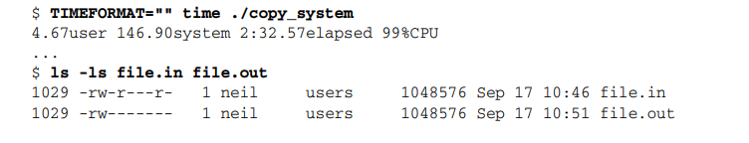
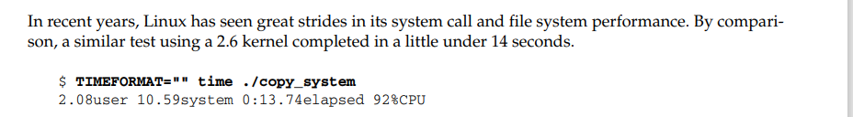
Cont(..)
Notes:
4.67user: User CPU time. This indicates that the process spent 4.67 seconds executing in user mode.
146.90system: System CPU time. This indicates that the process spent 146.90 seconds executing in kernel mode (handling system calls).
2:32.57elapsed: Elapsed (real) time. This indicates that the process took 2 minutes and 32.57 seconds to complete in total.
99%CPU: CPU usage. This indicates that 99% of CPU time was utilized by the process during execution.

Slide 14
Low-Level File Access
Running the program will give something like the following
TIMEFORMAT="" time ./copy_system
ls file.in file.out
A Second File Copy Program (copy_block.c) You can improve matters by copying in larger blocks. Take a look at this modified program, copy_block.c, which copies the files in 1K blocks, again using system calls:
$ rm file.out $ TIMEFORMAT="" time ./copy_block
copy_block.c
#include <unistd.h>
#include <sys/stat.h>
#include <fcntl.h>
#include <stdlib.h>
int main(){
char block[1024]; int in, out, nread;
in = open("file.in", O_RDONLY);
out = open("file.out", O_WRONLY|O_CREAT, S_IRUSR|S_IWUSR);
while((nread = read(in,block,sizeof(block))) > 0)
write(out,block,nread);
exit(0);
}
Notes:
After read() is called once, the file descriptor's internal position pointer is automatically moved to the next byte in the file. So, when read() is called again in the next iteration of the loop, it reads the byte that follows the one previously read.
Question how many system calls made?

Slide 15
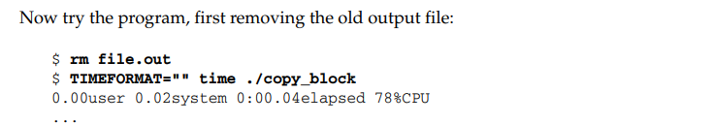
Cont(…)
How many system calls ?

Slide 16
Low-Level File Access
A Third File Copy Program (copy_stdio.c) where stdio providing interface to low-level I/O system calls the equivalent of low level file descriptor is stream.
3 streams automatically open when program starts.
$ TIMEFORMAT="" time ./copy_stdio
copy_stdio.c
#include <stdio.h>
#include <stdlib.h>
int main(){
int c;
FILE *in, *out;
in = fopen("file.in", "r");
out = fopen("file.out", "w");
while((c = fgetc(in)) != EOF)
fputc(c,out);
exit(0);
}
Notes:
Stdin
Stdout
Stderr these 3 streams are provided by stdio.h

Slide 17
Low-level I/O
1️⃣ open, read, write (Low-Level I/O – System Calls)
These functions interact directly with the OS kernel and provide more control over file handling.
✅ Characteristics:
Unbuffered → Data is read/written directly without buffering.
Faster for large files but requires manual handling of buffering.
More control over file permissions using flags like O_RDONLY, O_WRONLY, etc.
Returns file descriptors (integers) instead of FILE* pointers.

Slide 18
High-Level I/O
2️⃣ fopen, fread, fwrite (High-Level I/O – C Standard Library)
These are buffered functions from <stdio.h>, built on top of system calls.
✅ Characteristics:
Buffered I/O → Improves performance by reducing system calls.
Works with FILE pointers (FILE*), making it easier to handle files.
More user-friendly but slightly slower for very large files.
Supports formatted input/output (e.g., fprintf, fscanf)

Slide 19
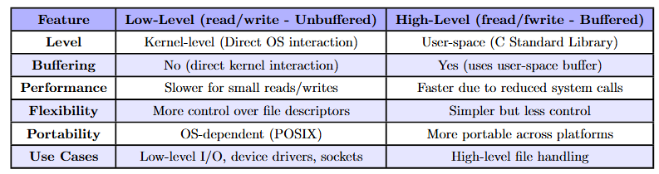
Comparison

Slide 20
Thank You
Questions?

